Slide 1


"Prediction of House SalePrice with Advanced Machine Learning Models."
- Abhinav thupili

Slide 2

Problem Statement
The challenge we're addressing is accurately predicting house sale prices using machine learning techniques. Traditional pricing methods often need more precision due to subjectivity and limited variables. Our task is to develop advanced models that harness the power of data to provide more precise predictions. By doing so, we aim to revolutionize the real estate industry by empowering stakeholders with reliable and data-driven price estimates.

Slide 3

Dataset Overview
Source of the Dataset: The dataset was retrieved from the Kaggle website.
File descriptions:
train.csv - the training set ( 1460 observations and 81 variables).
test.csv - the test set ( 1460 observations and 80 variables).
Some attributes of the dataset:
OverallQual(num): Overall material and finish quality.
LotArea(num): Lot size in square feet.
Street(char): Type of road access.
YrSold(num): Year Sold.
SaleType(char): Type of sale.

Slide 4

Data Preparation & Exploration
The following steps were taken for data preparation:
Checking for Missing values.
Handling Categorical variables.
Handling Numerical Variables.
Handling Outliers.

Slide 5
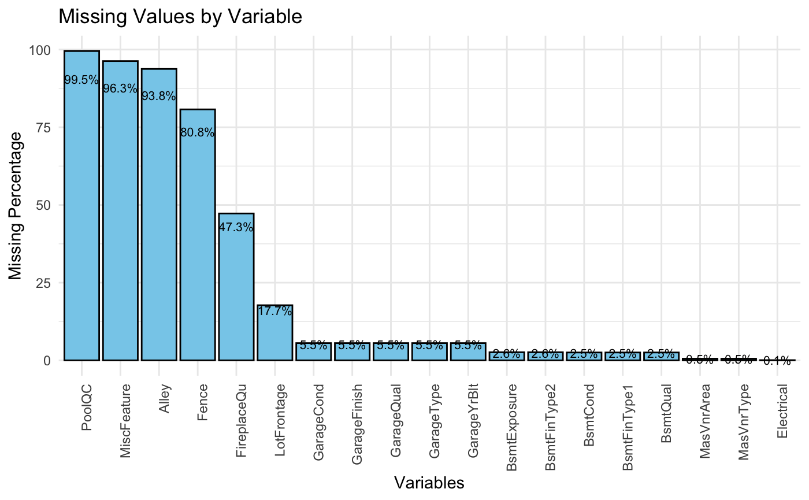

Slide 6
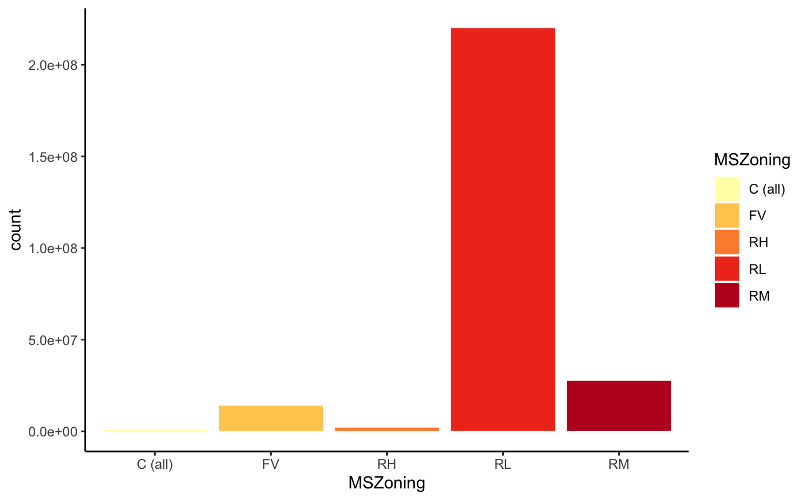
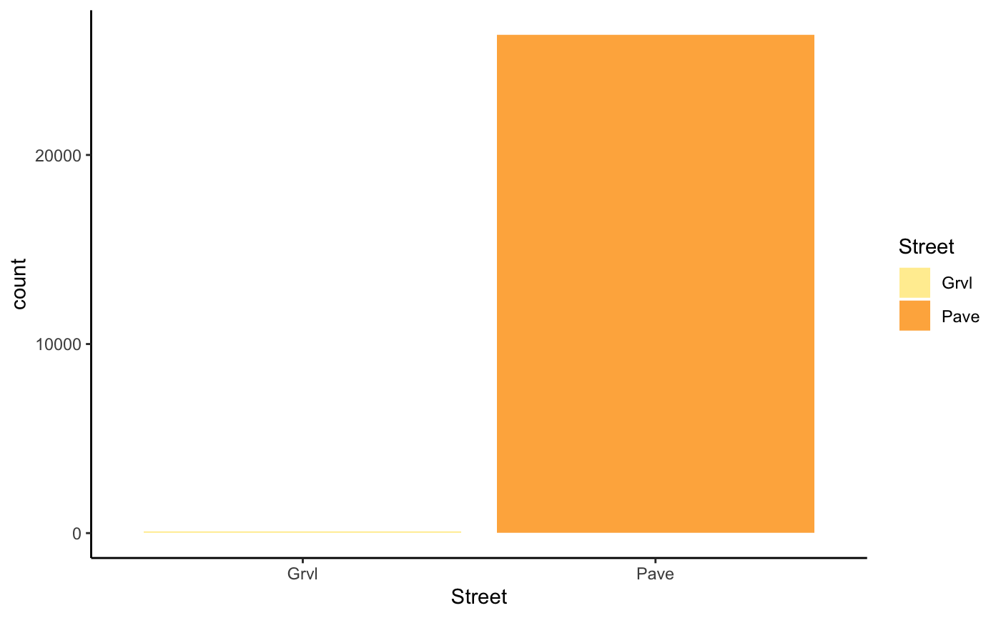
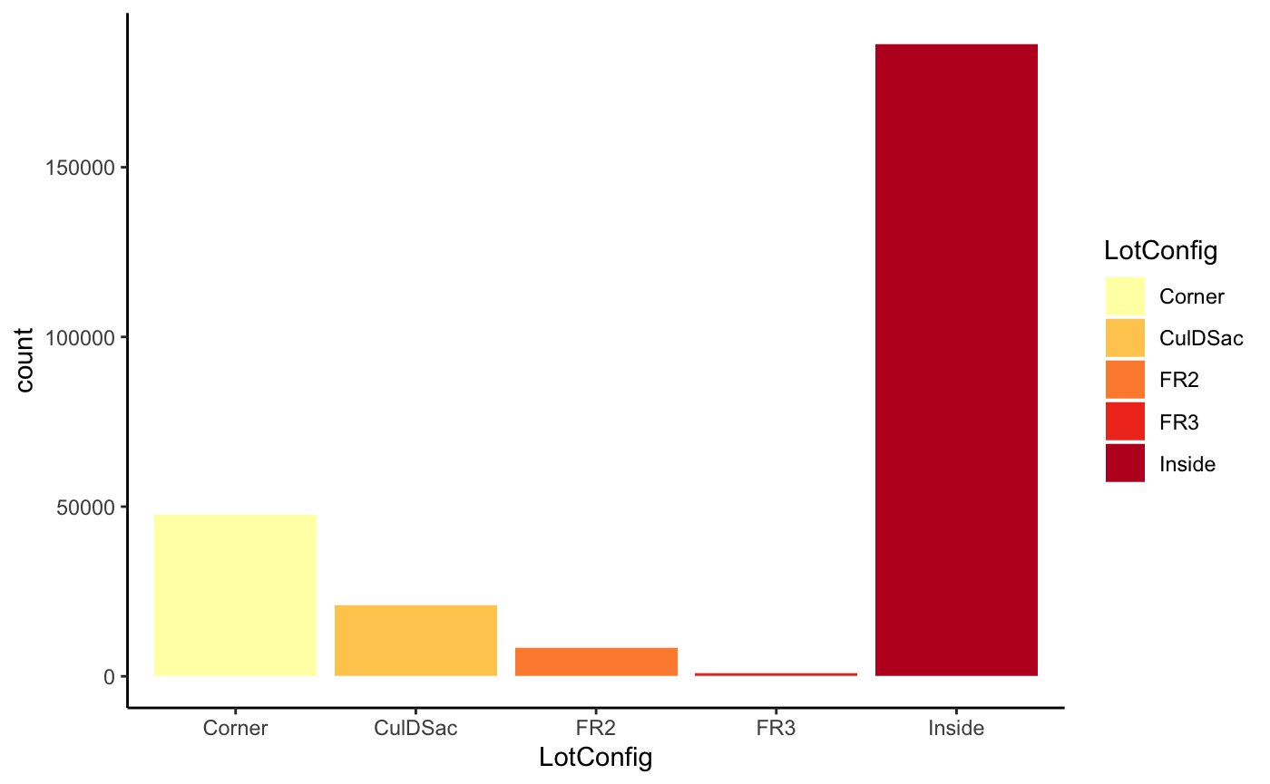

Slide 7
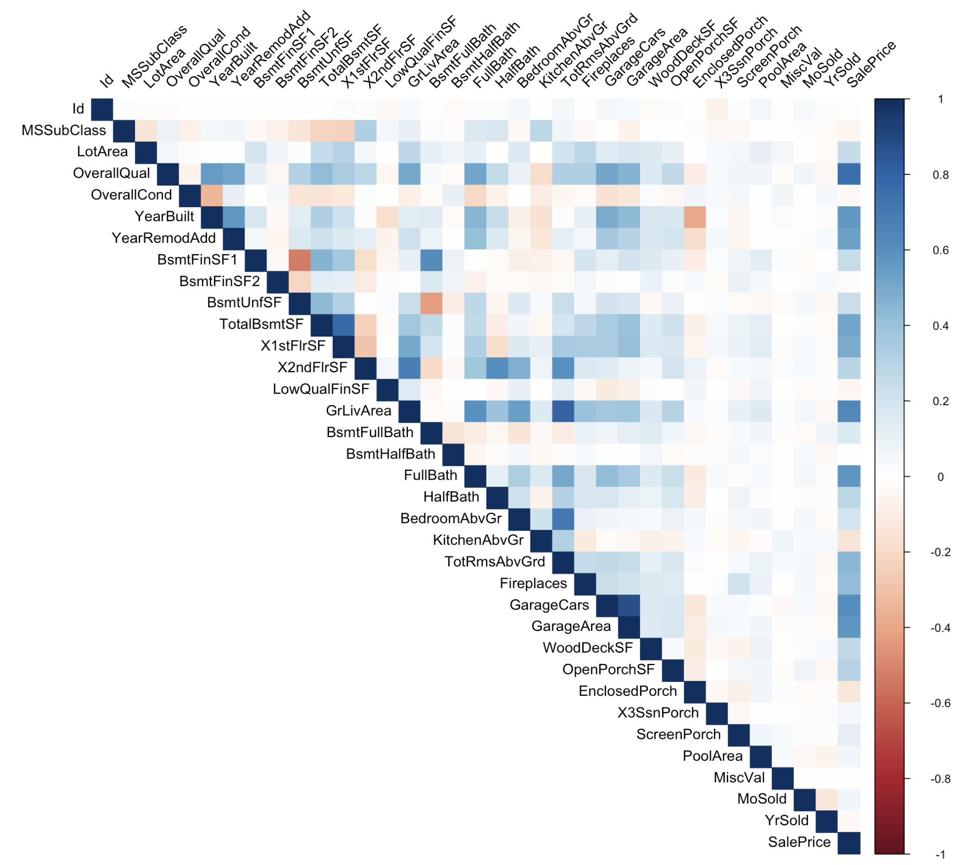
Notes:
Data Visualization of all numerical attributes.

Slide 8
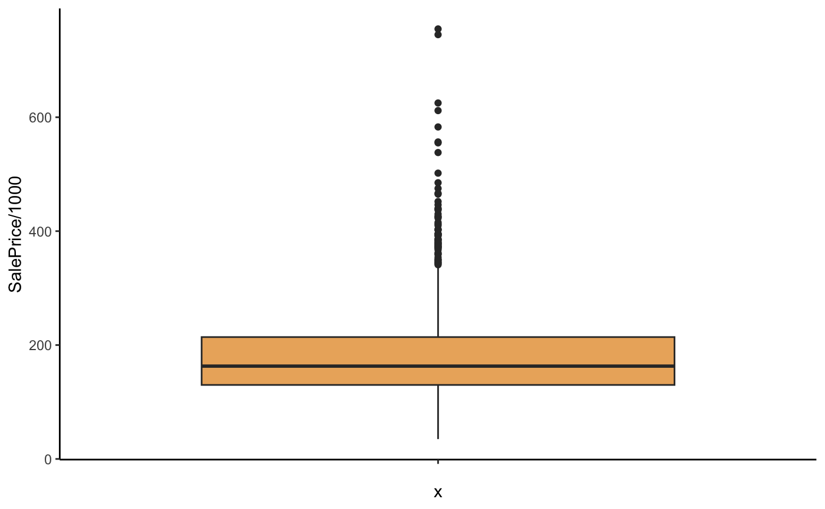
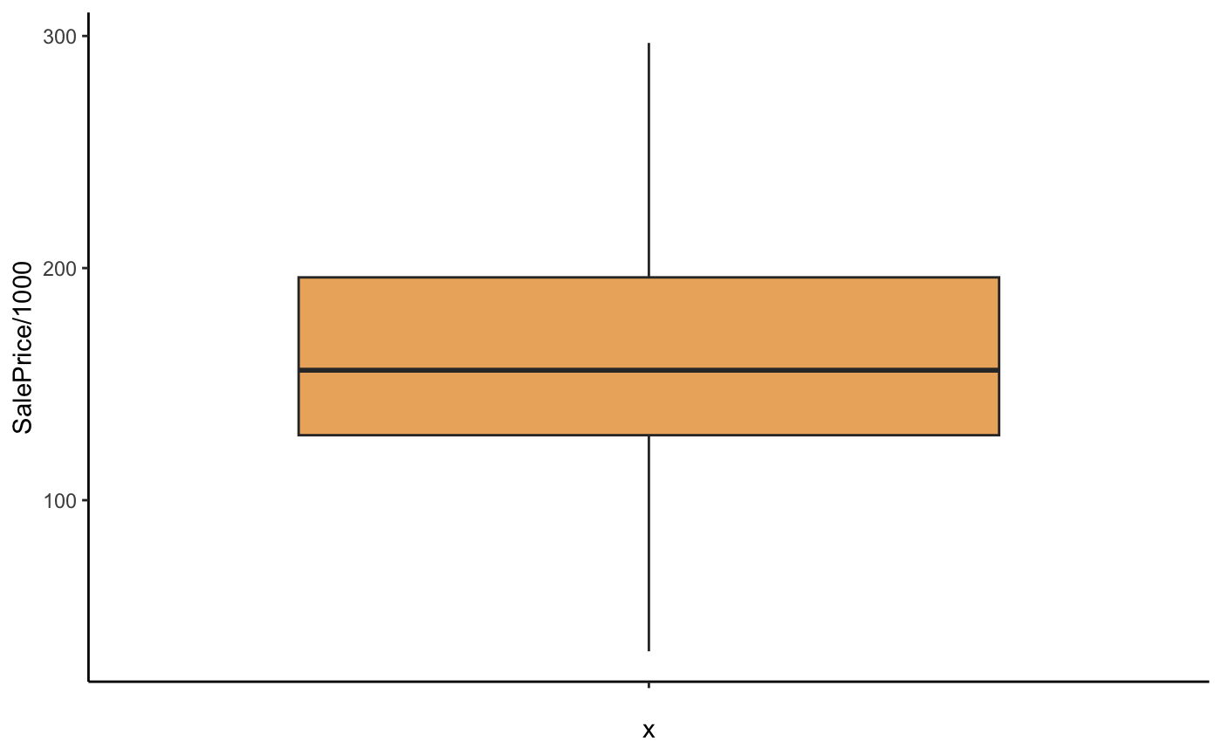
Handling of Outliers in “SalePrice” Column
Before removing Outliers
After removing Outliers

Slide 9

Modeling Approach
A total of six machine learning algorithms were used to find the best model for the current problem(based on R-squared value):
GBM (Gradient Boosting Machine) : 0.8411357
GLM (Generalized Linear Model) : 0.7496593
Lasso Regression (Lasso) : 0.7615173
LM (Linear Regression) : 0.7464322
RF (Random Forest) : 0.8236849
xgbLinear (XGBoost Linear) : 0.7885838

Slide 10
Performance Evaluations
The final GBM Model Metrics are as follows:
RMSE | R-squared | MAE
17990.46 | 0.8849166 | 12778.11

Slide 11
Insights & Conclusions
Table based on variables with respective Importance:
Important Variables more than 90 | Important Variables between 10-89 | Important Variables less than 5
OverallQual – (Rates the overall material and finish) | GrLivArea–(Above grade (ground) living area square feet). TotalBsmtSF–( Total square feet of basement area). YearBuilt. GarageArea. LotArea. FullBath. BsmtFinSF1–(Type 1 finished square feet). YearRemodAdd – (Remodel date). Fireplaces. | OpenPorchSF – (Open porch area in square feet). HalfBath. BsmtUnfSF – (Unfinished square feet of basement area). LandSlope – (Slope of property). MoSold – (Month sold). MSSubClass– ( Identifies the type of dwelling involved in the sale).

